Slide 1
Fuzzy Logic: Humidity Control System
CI – Prof. George Papadourakis, Ph.D.
Trivizakis Eleftherios MP143, Tzagkarakis Konstantinos MP141

Slide 2
Introduction
Humidity is a serious problem for
Warehouses
Residents
Data Center
Buildings
Commercial devices mostly lack of a proper control system
Need for a central control system for large infrastructures

Slide 3
Tools & Development
Notepad++
Editing the script
Fuzzy Control Language
jfuzzylite library
for implementing the fcl into application
Multiple engine support (mamdani, takagi-sugeno, tsukamoto)
qtfuzzylite (community edition)
Run fcl scripts with visual interface
Exports to other languages
Uses takagi-sugeno engine
Supports multiple Oses + freeware

Slide 4
Introduction
Variables
Humidity (%)
input= Humidity/DRY + Humidity/NOT_TOO_DRY + Humidity/EE_SUITABLE + Humidity/SUITABLE + Humidity/NOT_TOO_WET + Humidity/WET
SpeedFan (%)
output=SpeedFan/STOP + SpeedFan/SLOW + SpeedFan/EE_MEDIUM + SpeedFan/MEDIUM + SpeedFan/FAST + SpeedFan/VERY_FAST
Inputs
DRY, NOT_TOO_DRY, EE_SUITABLE, SUITABLE, NOT_TOO_WET, WET
Outputs
STOP, SLOW, EE_MEDIUM, MEDIUM, FAST, VERY_FAST
Rules
Expressed in High-level script
Ex. if Humidity is DRY then SpeedFan is STOP

Slide 5
Values FUZZIFY and DEFUZZIFY
FUZZIFY | RANGE(%)
DRY | 0-21
NOT_TOO_DRY | 17-43
EE_SUITABLE | 38-48
SUITABLE | 44-54
NOT_TOO_WET | 50-75
WET | 70-100
DEFUZZIFY | RANGE (%)
STOP | 0-5
SLOW | 2.5-15
EE_MEDIUM | 7.4-35
MEDIUM | 21.2-50
FAST | 35.6-80
VERY_FAST | 57.8-100

Slide 6
Values FUZZIFY and DEFUZZIFY
FUZZIFY | RANGE(%) | DEFUZZIFY
DRY | 0-5 | STOP
NOT_TOO_DRY | 2.5-15 | SLOW
EE_SUITABLE | 7.4-35 | EE_MEDIUM
SUITABLE | 21.2-50 | MEDIUM
NOT_TOO_WET | 35.6-80 | FAST
WET | 57.8-100 | VERY_FAST

Slide 7
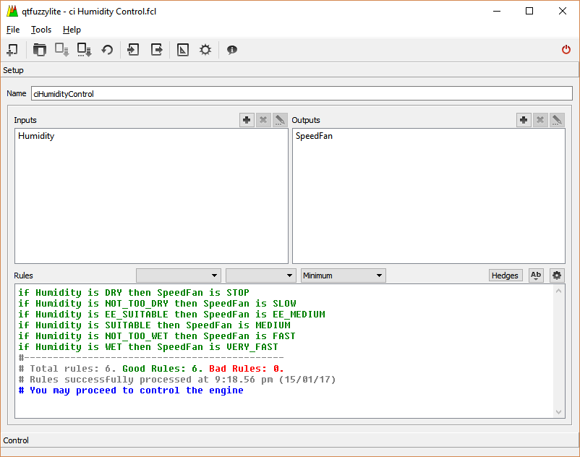
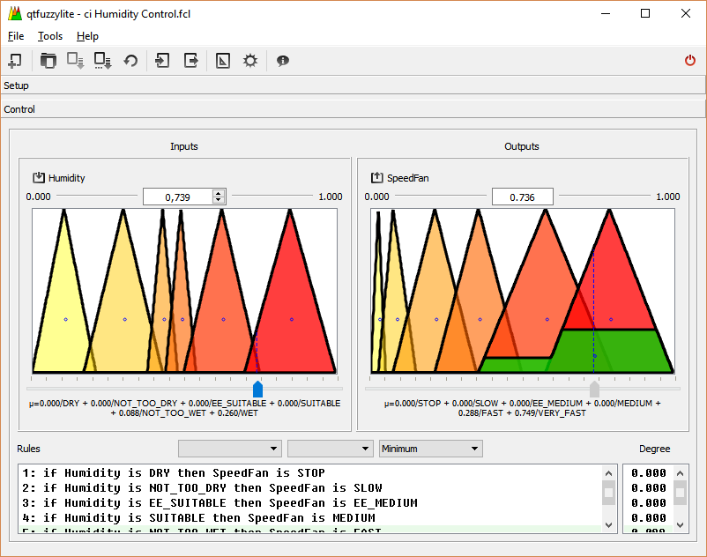
User interface of qtfuzzylite

Slide 8
References
[1]http://www.fuzzylite.com/java/, 20 Dec. 2016
[2]http://www.fuzzylite.com/qt/, 20 Dec. 2016
[3]https://www.youtube.com/channel/UCm1zXmxX1gcW-uKMT4gPiLQ, 20 Dec. 2016
[4] I.J. Nagarath,M. Gopal, Control systems engineering, New Delhi,New age international (P) limited,2007
[5]http://www.cse.lehigh.edu/~munoz/CSE335/classes/FuzzyLogic.ppt
[6] Technical case studies on fuzzy logic control system from http://www.wikipedia.org, http://sciencedirect.com/, http://aptronix.com ,http://www.mastertherm.co.uk/heat-pumps-residential-use/how-does-heat-pump-work
[7] Shakowat Zaman Sarkar, “A proposed Air–conditioning systemusing Fuzzy Algorithm for Industria Application” ICSE IEEE Proc. (2006) 832-834

Slide 9
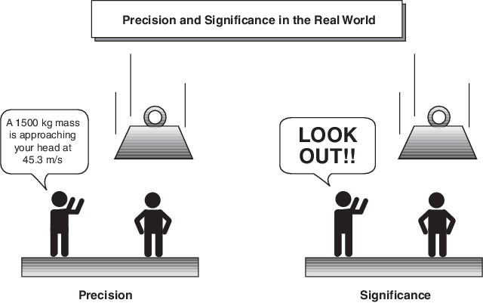
thx!

